Slide 1








Reaction and Learning Evaluation of the ACoRD RLOs
Chin Hai Teo
UM eHealth Unit, Faculty of Medicine, Universiti Malaya, Kuala Lumpur
On behalf of the ACoRD Team

Slide 2
Background
The ACoRD project has started in Nov 2018 – May 2022.
Capacity building project to develop reusable learning objects (RLOs) in Malaysia.
Guided by the University of Nottingham UK, University of Stavanger, Karolinska Institutet.
Funded by the European Union ERASMUS+ Capacity Building in Higher Education (CBHE) programme.
2

Slide 3

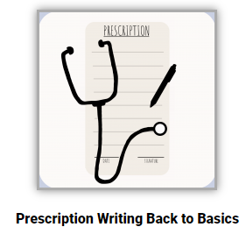

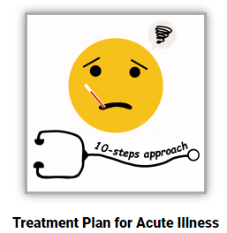


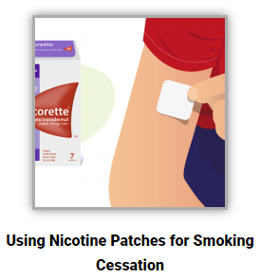
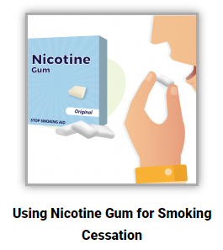
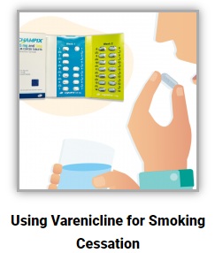

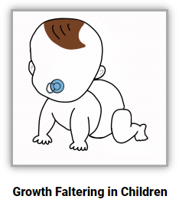



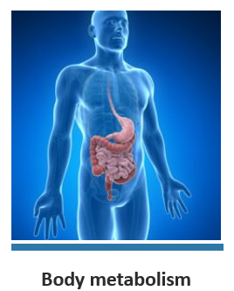
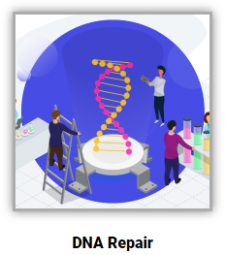
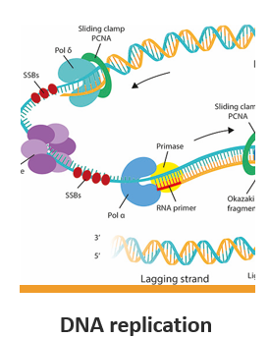

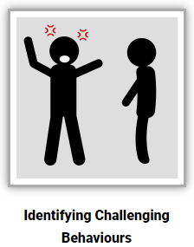



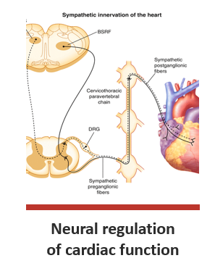
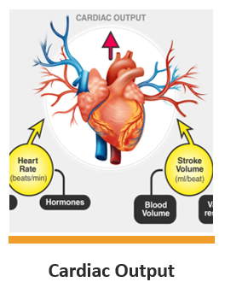
Background
Please visit acord.my to view the RLOs.
23 reusable learning objects (RLOs) of various health-related topics

Slide 4
Background
Objective: This study aimed to evaluate users’ reaction on using the RLOs and its impact on learning.
4

Slide 5
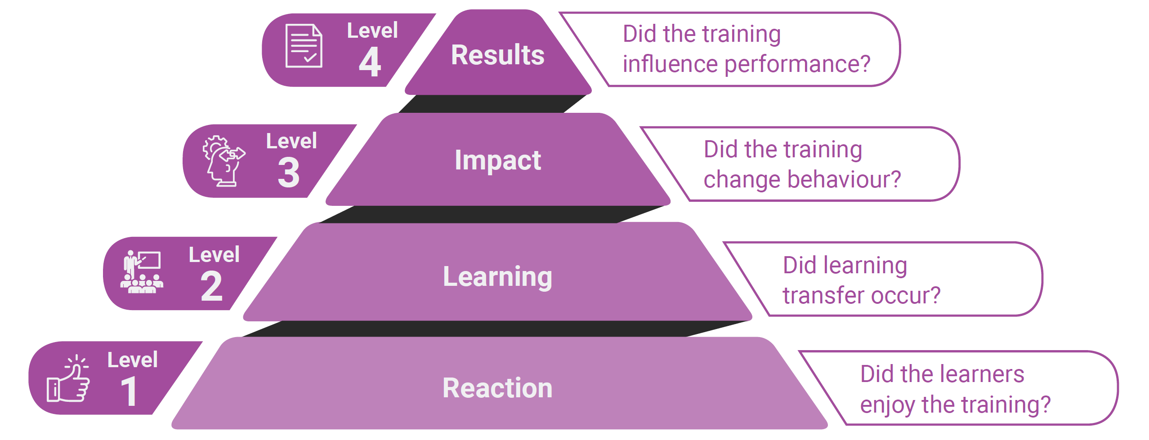
Methods
The evaluation of the RLOs was guided by Kirkpatrick’s Model focusing on Reaction and Learning.

Slide 6
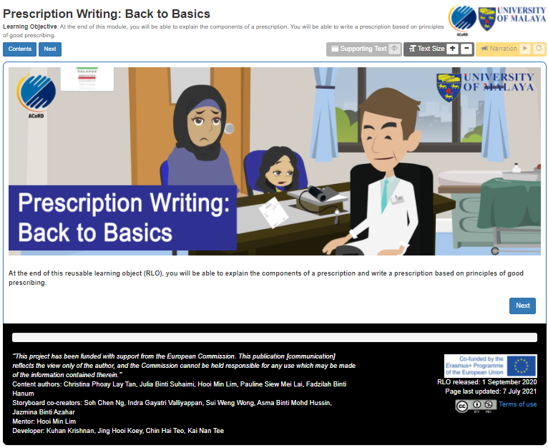
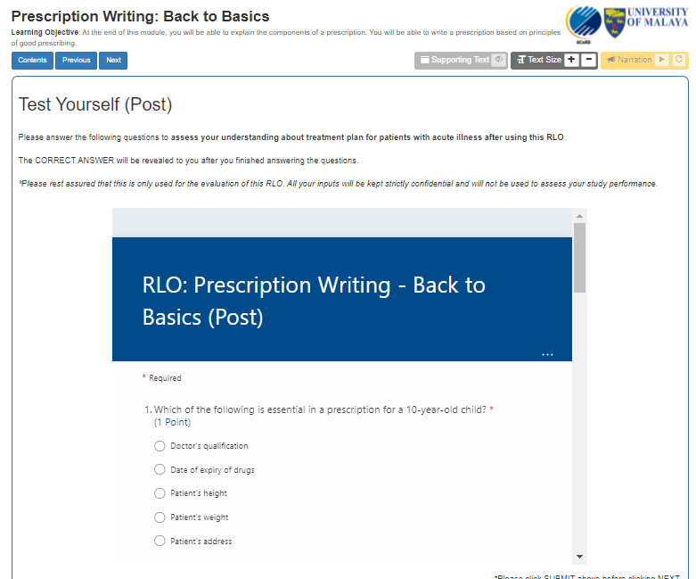
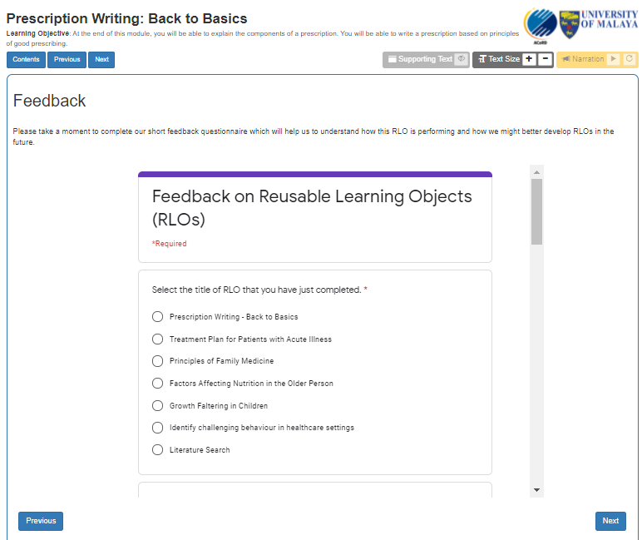
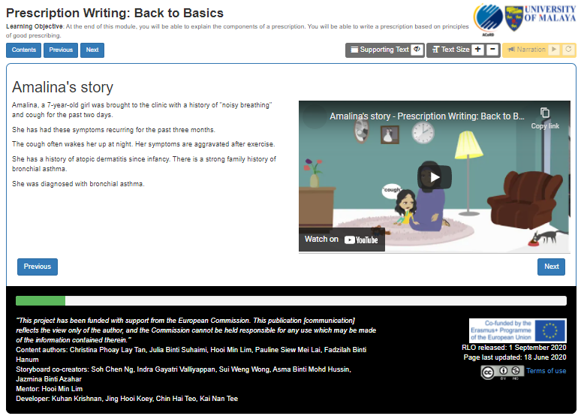
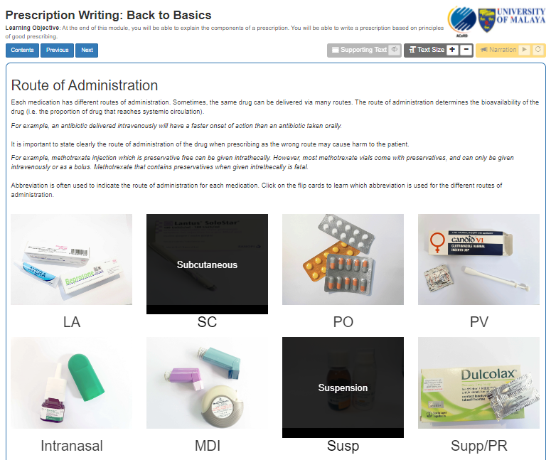
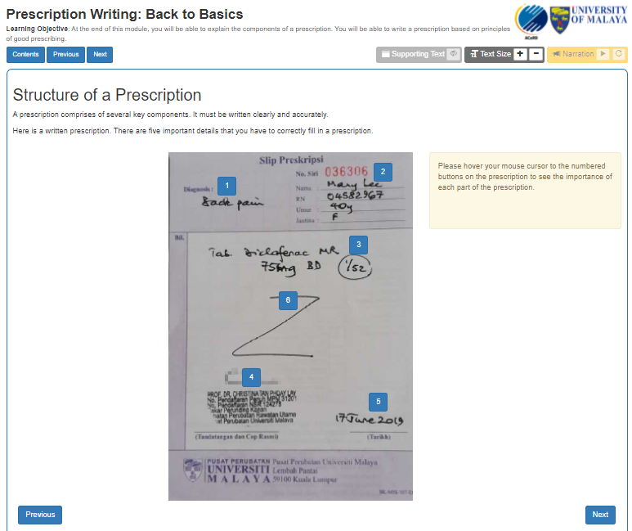
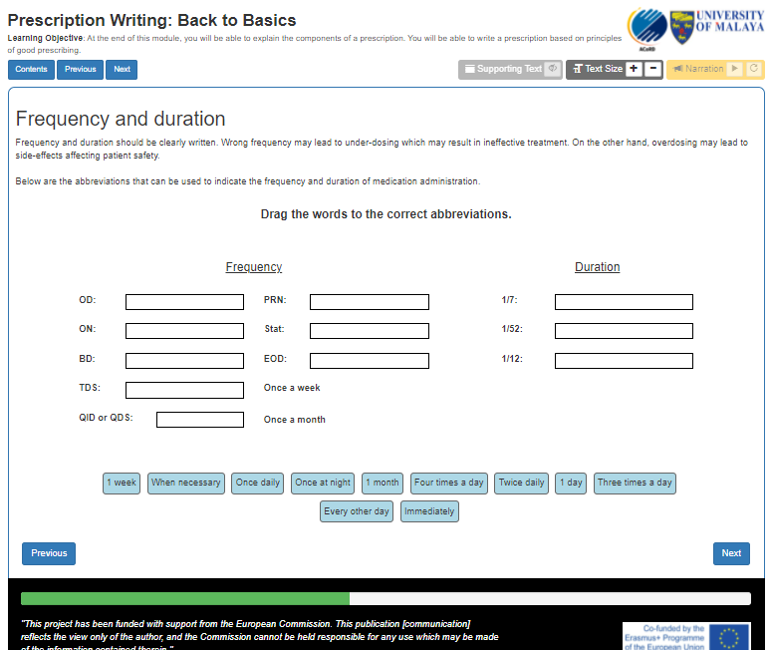
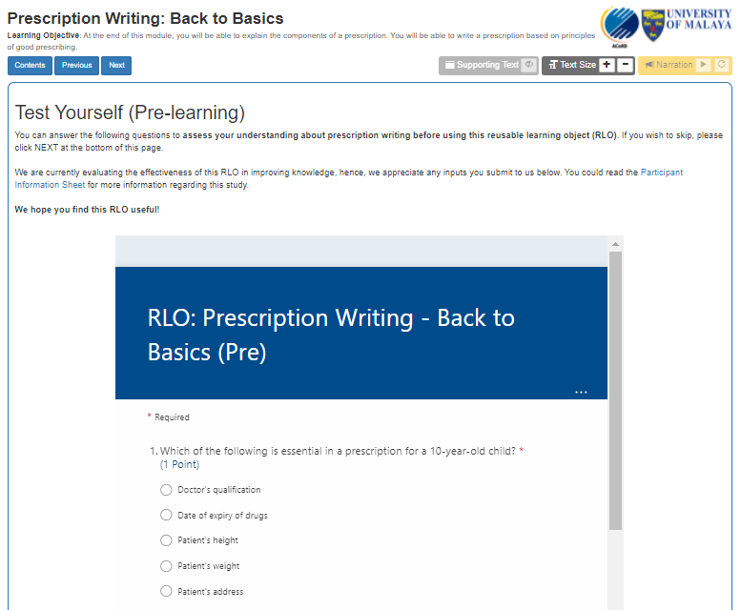
Methods
Immediate-post-use
LEARNING questionnaire
REACTION questionnaire
Pre-use
6-week post-use
Main content (6-10 pages depending on topic)
LEARNING questionnaire
LEARNING questionnaire

Slide 7
Methods
REACTION questionnaire
usefulness, user-friendliness and open-ended reaction comments
analysed descriptively and thematically
LEARNING questionnaire
questions on knowledge and confidence were set according to each RLO topic
knowledge score and confidence level at different timepoints were compared using inferential statistics

Slide 8
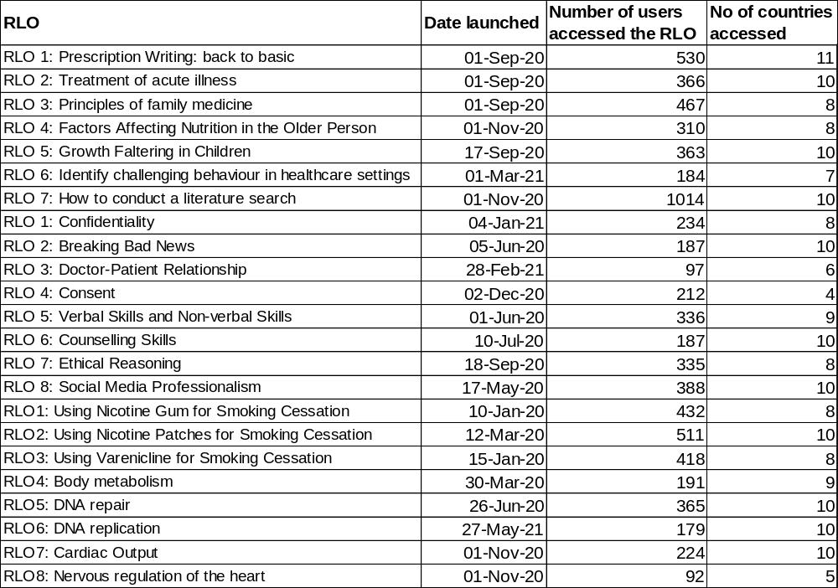
Results (Reach)
As of 24 Feb 2022,
7622
people accessed
any of the ACoRD RLOs, accumulatively
who were from
11
countries globally.

Slide 9
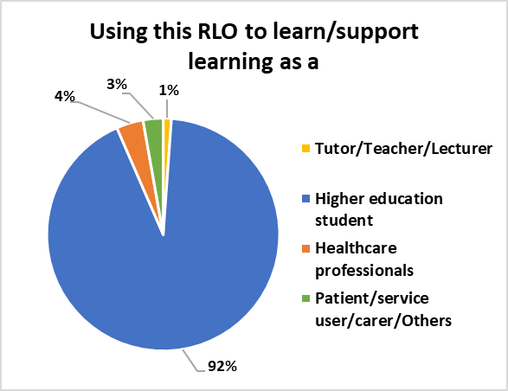
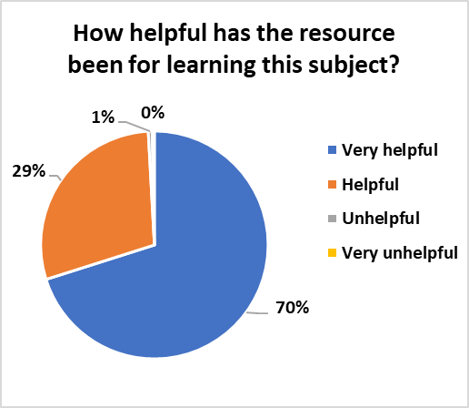
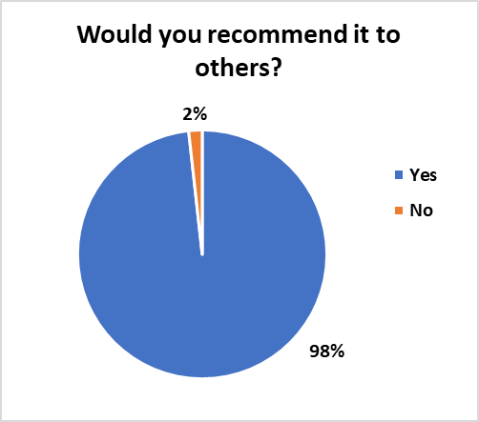
Results (Reaction)
N=2118
N=2071
N=2175

Slide 10

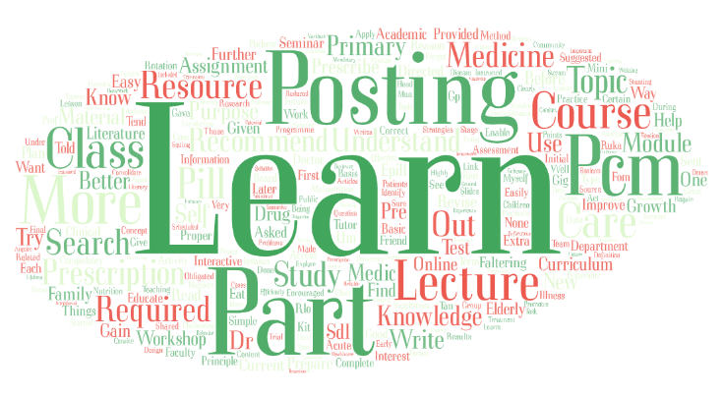
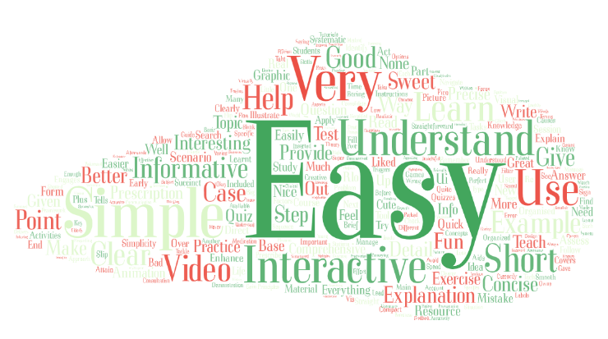


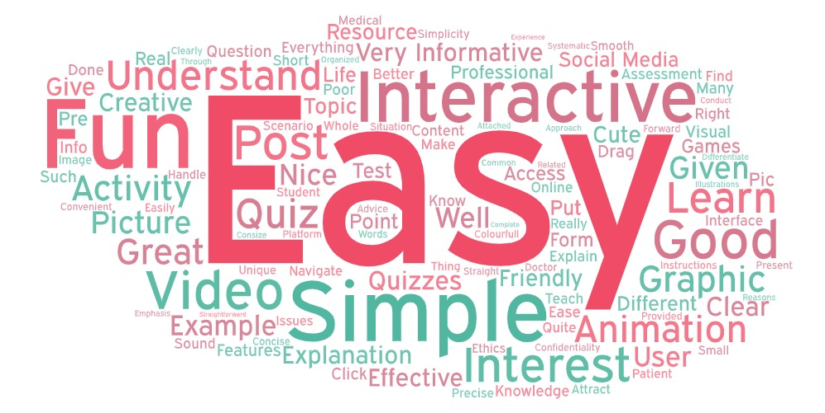
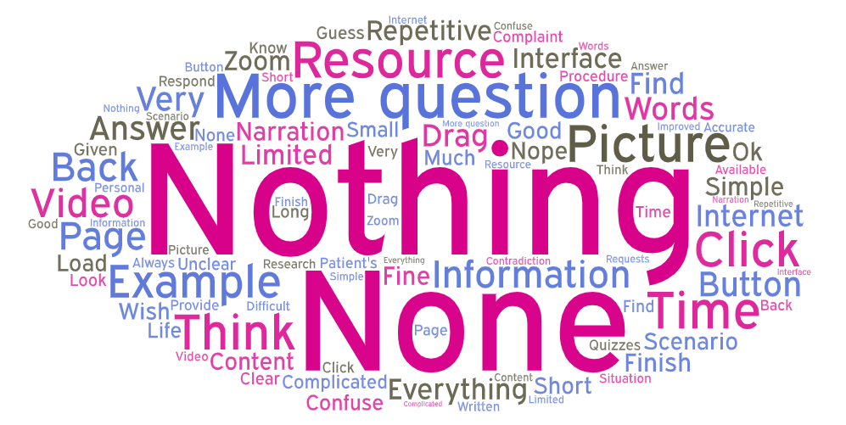
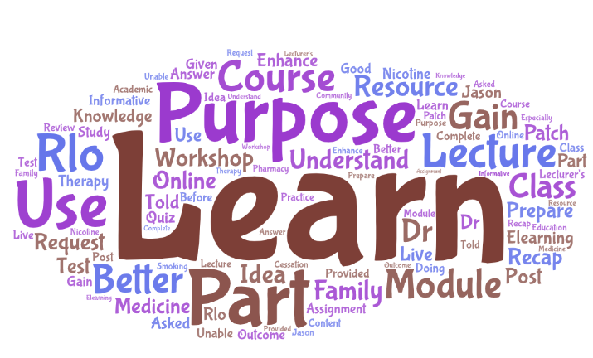
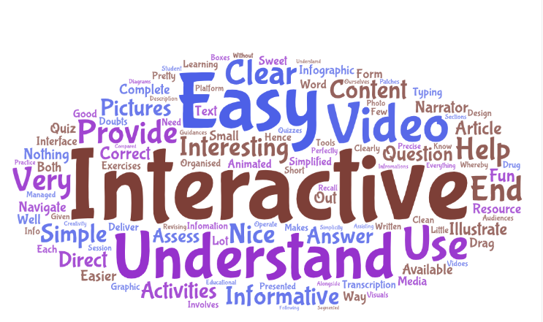
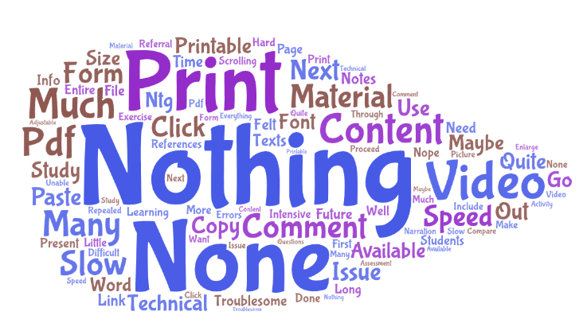
Results (Reaction)
What was your main reason for using this resource?
What did you most like about this resource?
What did you least like about this resource?

Slide 11
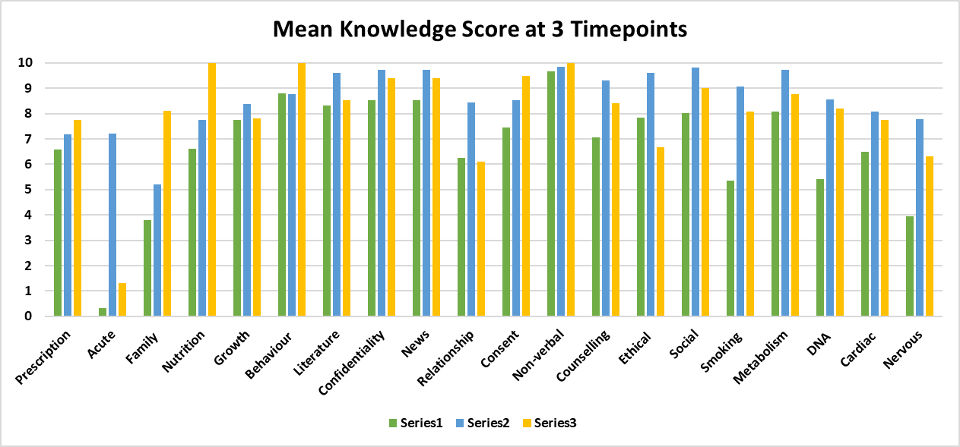
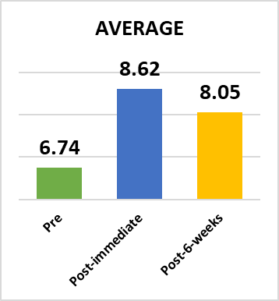

Results (Learning)
*
*
*
*
*
*
*
*
Mean knowledge score increased from pre (6.74) to post-immediate (8.62) and decreased slightly at post-6-weeks (8.05)
*Sample size <10
Pre vs Post-immediate (P<0.001)
Pre vs Post-6-week (P<0.001)

Slide 12
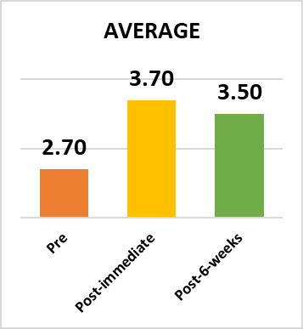
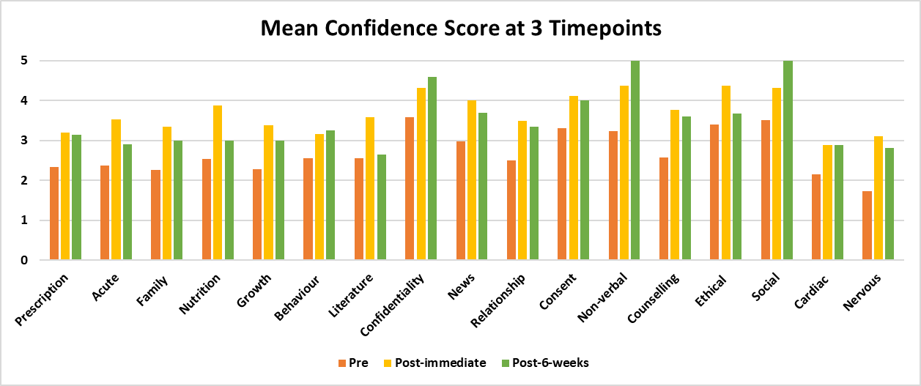
Results (Learning)
*
*
*
*
*
*
*
*
*
Mean confidence score increased from pre (2.70) to post-immediate (3.70) and decreased slightly at post-6-weeks (3.50)
*Sample size <10
Pre vs Post-immediate (P<0.001)
Pre vs Post-6-week (P<0.001)

Slide 13
Discussion
Students have generally positive reaction towards RLOs due to its simplicity, ease of usage and interactivity, in all three 3 PCUs
Measurement of learners' performance showed significant improvement in the test assessments before and after implementation of the RLOs.
The retention of knowledge acquired was also demonstrated 6-weeks post exposure to the RLO, suggesting that it is helpful in supporting the attainment of learning outcomes.
Past studies have reported that RLOs improved knowledge (Windle RJ et al. BJET 2010). This study share similar findings, besides adding to the body of evidence about knowledge retention after using RLOs.

Slide 14
Discussion
Limitations due to the pragmatic data collection approach
  Low sample size at 6-week despite reminders
  RLOs launched at different timeline – different number of participants
  Baseline score for knowledge is quite high, difficulty to show difference (ceiling effect) – not restricted to new learners
Future studies could consider evaluation covering Kirkpatrick’s Behaviour (Lvl 3) and Results (Lvl 4).

Slide 15
Conclusion
This study suggested that the RLOs are effective in improving knowledge and confidence immediately and over time, with good user experience.
These RLOs should be disseminated to a wider context to benefit all.

Slide 16
Acknowledgement
A big THANK YOU to the:
Lecturers who have co-created and co-plan the evaluation
Students and users who have co-created, used and responded to the questionnaires
Managements who supported the project
EU partners (UoN, UiS, KI) for capacity building and knowledge sharing
ERASMUS+ for funding this project

Slide 17

Thank you!
17
17

